Slide 1

SE Linux Security Components
by Paras Garg
pgarg2@stevens.edu

Slide 2
What is Context / Label?
Label is like a process or a file attribute which shows the context of the resource. Label could be any attribute such as the owner or date of creation of process or file.
All the processes and files are labeled in a way that represents security information. This information is called SE Linux Context.

Slide 3
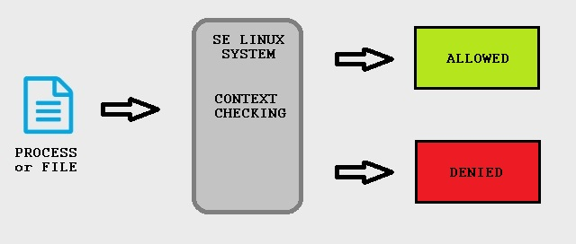
Why Context / Labeling?
Labeling is the most important aspect for maintaining a SE Linux system, as all SE Linux access control decisions are based on the label of resource.

Slide 4



What does Context have?
SE Linux Context contains additional information of process or file, such as
1. User 2. Role 3. Type / Domain 4. Level
(represents the SE
Linux user)
(represents the SE
Linux role)
(represents the SE
Linux type)
(represents the
sensitivity)

Slide 5

1. User
SE Linux user is different from Linux user.
SE Linux ensures the user is not allowed to access the resources of which they do not have permission.
Implements role-base access control.
By convention it is defined by a “_u” suffix which is not mandatory

Slide 6

2. Role
Role are used to define which types of user processes can be in. Roles help define what a user can and cannot do.
Types of roles – 1. user_r – This role is meant for restricted or end-user applications. 2. staff_r – This role is meant for non-critical operator tasks. 3. sysadm_r – This role is meant for system administration tasks. 4. system_r – This role is meant for background processes. 5. unconfined_r – This role is meant for end users.

Slide 7

3. Type
The type of a process (called the domain) defines the fine-grained access controls of that process with respect to itself or other types (which can be processes, files, sockets, network interfaces, and more).
SE Linux is able to control what an application is allowed to do based on how it got executed in the first place.

Slide 8

4. Level
Sensitivity label allows classification of resources and restriction of access to resources based on security clearance.
Sensitivity labels are needed for Multi Level Security.
These labels consists of two parts: a confidentiality value and a category value.

Slide 9

References
Red Hat SELinux Guide (2005), Red Hat, Inc. Retrieved from https://access.redhat.com/documentation/en-US/Red_Hat_Enterprise_Linux/4/html/SELinux_Guide/
Robert Krátký and Barbora Ančincová, Red Hat SELinux User Guide (2016), Red Hat, Inc. Retrieved from https://access.redhat.com/documentation/en-US/Red_Hat_Enterprise_Linux/6/html/Security-Enhanced_Linux/
Sadequl Hussain (2014, September 25), DigitalOcean. Retrieved from https://www.digitalocean.com/community/tutorials/an-introduction-to-selinux-on-centos-7-part-2-files-and-processes#selinux-for-processes-and-files.
Sven Vermeulen (2013), “SELinux System Administration”. Retrieved from http://ezproxy.stevens.edu:2155/book/operating-systems-and-server-administration/linux/9781783283170/firstchapter
IBM Knowledge Center, IBM. Retrieved from https://www.ibm.com/support/knowledgecenter/

